Slide 1
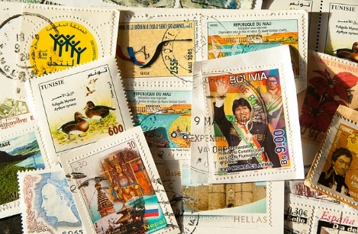
Daryl’s Really Different Stamp Collection

Slide 2
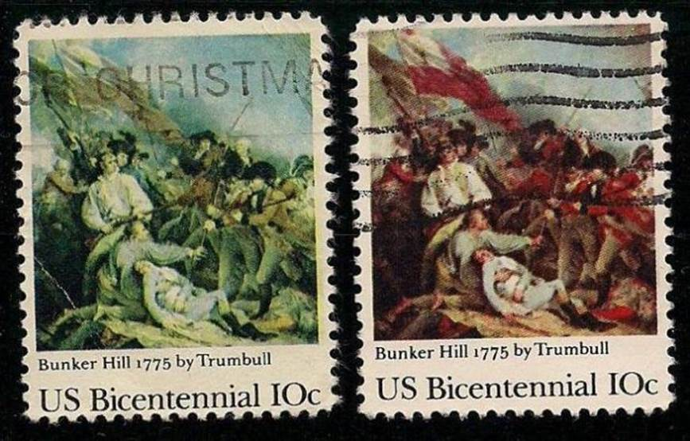
Missing Colour

Slide 3
Wrong Colour

Slide 4
Colour Shift

Slide 5
Invert Error

Slide 6
Miss-cut

Slide 7
Mistakes are worth something! (This mistake is worth $240,000)

Slide 8
God is Faithful!

Slide 9
God is Sovereign!

Slide 10
God is With You!

